Slide 1


An Examination of Chinese Food Labeling and Food Contact Regulations
January 17, 2018
Notes:
Thank you for joining us for the 2nd in our series on global food regulations. Today’s webinar is brought to you by experts from Decernis and the GMA SEF.

Slide 2

Notes:
We are the supporting non-profit to GMA. Our mission is to deliver innovative research, state of the art training and best in class education programs to the food industry and consumers. We partnering with many other training institutes, universities and non-profits across the globe to carry out our mission. One of our partners is National Institute of Food Technology Entrepreneurship and Management.

Slide 3

Agenda
Speaker introductions
Overview of Chinese food regulations
Food labeling requirements
Food contact regulations
Q&A

Slide 4




Expert Panel
Kevin C. Kenny, JD, LL.M Decernis Co-founder and Owner
Huqiu Zhang, Ph.D., Intertek
VP, Chemical Management, Product Assurance
Richard T. LeNoir, Decernis
Subject Matter Expert
Yingying Song, Decernis
Manager, Regulatory Affairs
Notes:
Kevin - Kevin Kenny is the co-founder and owner of Decernis and is an experienced regulatory attorney who has worked and consulted for 20+ years in the food and consumer products space. He advises some of the world’s largest manufacturers on Food, Food Contact and Supply Chain Compliance challenges globally. Working with a team of native speaker experts in all major markets, Kevin has led a Decernis team effort to expand regulatory coverage to over 200 countries.
Our other speakers today include Richar LeNoir, SME from Decernis and Yingying Song, Decernis. And Huqiu Zhang, VP, Chemical Management and Product Assurance at Intertek. Our moderator, Kevin Kenny will introduce the speakers in more detail.

Slide 5
Upcoming Training Opportunities from GMA SEF
Sanitation Operator Train-the-Trainer
  April 24-27, 2018
  Minneapolis, MN
Food Processing Metal Detector Training
  Online, on-demand
  gmasef.litmos.com/online-courses

Slide 6
China Labeling Regulations
Ms. Yingying Song
GMA Webinar
17 January 2018

Slide 7
China Labeling -- Administration
AQSIQ oversees inspection and supervision of food labels of import and export prepackaged foods
AQSIQ Announcement No 27/2012 - Management provisions on inspection and supervision of food labels of import and export prepackaged foods
12 December 2017 - Management measures on inspection and supervision of food labels of import and export prepackaged foods – will enter into force on 1 October 2018
GMA Webinar – 17Jan2018
Notes:
7

Slide 8
China Labeling -- Administration
Some changes:
Importer responsible to audit Chinese label before importation and must keep documents for at least 2 years
Corporate pledge required when declaring for inspection
Import for the second time:
If a batch of import foods is selected, the authority shall conduct an on-the-spot inspection and a label inspection
If a batch of import foods is not selected, then based upon pledges by importer or agent, authority will conduct docs examination and thereafter batch can be released
GMA Webinar – 17Jan2018
Notes:
8

Slide 9
China Labeling -- Applicable Standards
GB 7718-2011 General Standard for the Labeling of Prepackaged Foods
GB 28050-2011 General Rules for Nutrition Labeling of Prepackaged Foods
GB 13432-2013 Labeling of Prepackaged Foods for Special Dietary Uses
GB 10789-2015 General Standard for Beverage
GB 29924-2013 General Rules for Food Additives Labeling
Other Safety Standards/Hygienic Standards/Product Standards (National, Industry, Local, Enterprise)…
  GB 19302-2010 Fermented Milk
  GB 10765-2010 Infant Formula
  GB 2758-2012 Fermented alcoholic beverages and their integrated alcoholic beverages
  GB 8537-2008 Drinking Natural Mineral Water
  ……
GMA Webinar – 17Jan2018
Notes:
9

Slide 10
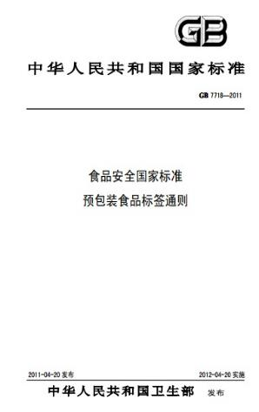
GB 7718-2011: General Standard for the Labeling of Prepackaged Foods
Applies to the labeling of prepackaged foods offered directly or indirectly to consumers
Does not apply to food storage and transportation labels that protect prepackaged foods during storage and transportation / labels for bulk foods / made-on-site foods
GMA Webinar – 17Jan2018
Notes:
10

Slide 11
GB 7718-2011
Labeling Items | Offering directly | Offering Indirectly
Product name | ✔ | ✔
Ingredient list | ✔ | *
Quantitative labeling of the ingredients | ✔ | *
Net content and specifications | ✔ | ✔
Name/address/contact of manufacturer and distributor | ✔ | *
Date (production and shelf-life) | ✔ | ✔
Storage conditions | ✔ | ✔
Food production license number | ✔ | *
Product standard | ✔ | *
Other mandatory labeling information | ✔ | *
*Note: For indirectly offered foods, this information should still be declared in the user guide or contract of the product although not required on the external package
GMA Webinar – 17Jan2018

Slide 12
Ingredient List
List of ingredients:
  In descending order of their weights
  Except ingredients comprising less than 2% of the food
List of food additives:
  In descending order of their weights
  Use one of the recommended formats from Annex B
Must include “water” used when manufacture or processing (except water evaporated and other volatile ingredient)
Must include the raw materials for the edible packaging
Certain ingredients have their own labeling format:
  Vegetable oil or refined vegetable oil, starches, spices and extracts, chewing gum bases, preserved fruits, flavorings
GMA Webinar – 17Jan2018

Slide 13
Other Labeling Items
GMOs
  Mandatory, according to “Food Safety Law”
Irradiated Food
  Mandatory for both irradiated food and any irradiated ingredient
Nutrition Labeling
  GB 13432: Foods for Special Dietary Uses, Baby Foods
  GB 28050: Other Foods
Allergen: Voluntary
  Gluten-containing grains, crustaceans, fish, eggs, peanut, soybean, dairy (including lactose), nuts
GMA Webinar – 17Jan2018
Notes:
13

Slide 14
Other Labeling Items
Art 4.3.1 The following prepackaged foods can be exempted from labeling the shelf life:
  Alcoholic beverages where alcohol content is equal to or higher than 10%
  Vinegar
  Salt
  Sugars in solid form
  Monosodium Glutamate
GMA Webinar – 17Jan2018
Notes:
14

Slide 15
Regarding Imported Foods
Art 4.1.6.3
For imported prepackaged foods, must label country of origin or region of origin (such as Hong Kong, Macau, Taiwan), and name, address and contact of legally registered agent, importer or distributor in China.
The name, address and contact of the manufacturer may not be included in the label.
GMA Webinar – 17Jan2018

Slide 16
Regarding Imported Foods
Art 3.8.2
Foreign characters may be used if simultaneously corresponding to Chinese (except trademark, manufacturer and address of imported foods, name/address and website of overseas distributors)
Foreign characters shall not be larger than the corresponding Chinese characters (except trademark)
Q&A No.56 How to mark the food labels?
Everything found in ingredient list of the original foreign language shall be also included in the corresponding Chinese label
Exempt from labeling requirements of product standard code and quality grade
GMA Webinar – 17Jan2018

Slide 17
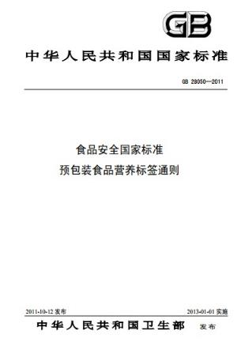
GB 28050-2011: General Rules for Nutrition Labeling of Prepackaged Foods
Apply to nutrition labeling of prepackaged foods
Does not apply to health foods and prepackaged foods for special dietary uses
As a component of prepackaged foods labeling (GB 7718)
Includes:
  Nutrition information panel
  Nutrient claims
  Nutrient function claims
GMA Webinar – 17Jan2018
Notes:
17

Slide 18
Nutrition Information Panel
Mandatory labeling of:
  Content and NRV% of Energy + 4 key nutrients (protein, fat, carbohydrates, sodium)
  Content and NRV% of corresponding nutrition component after nutritive fortifier is added
  Content of trans fatty acid if hydrogenated/partially-hydrogenated oil is used
  Content labeling is required if an NRV has not yet been developed
  Content and NRV% of the corresponding nutrition component if a content claim or function claim has been made
GMA Webinar – 17Jan2018
Notes:
18

Slide 19
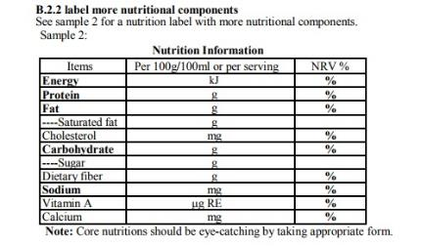
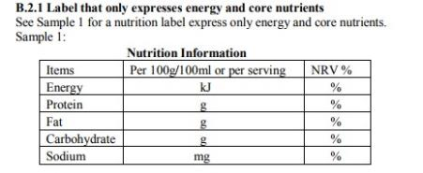
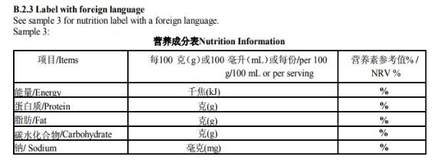
Six Recommended Formats
One of these six formats shall be selected for nutrition labeling
GMA Webinar – 17Jan2018
Notes:
19

Slide 20
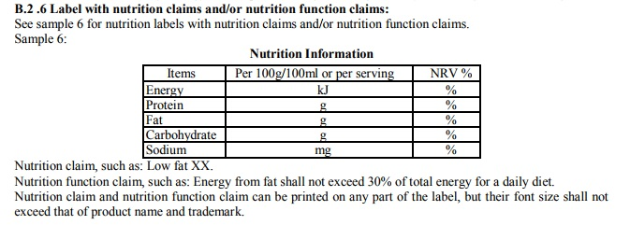
Six Recommended Formats
One of these six formats shall be selected for nutrition labeling
GMA Webinar – 17Jan2018
Notes:
20

Slide 21
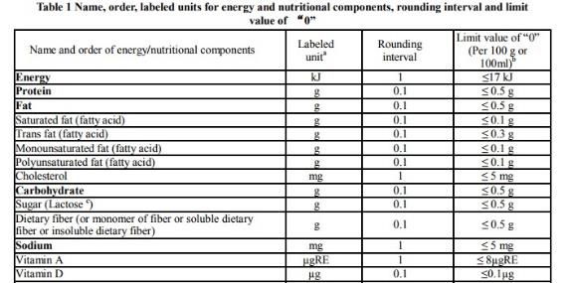
Optional Labeling Items
Other nutrition components
  Vitamin A, Vitamin C, Calcium, etc. (Table 1)
GMA Webinar – 17Jan2018
Notes:
21

Slide 22
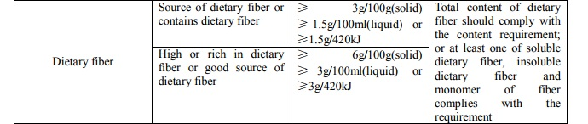
Optional Labeling Items
Other nutrition components
  Vitamin A, Vitamin C, Calcium, etc. (Table 1)
Claims – if a nutrition component:
  Meets content requirements and restrictive conditions in Table C.1 → Nutrition Content Claim
  No xxx, Low xxx, High xxx, Source of xxx, etc.
GMA Webinar – 17Jan2018
Notes:
22

Slide 23
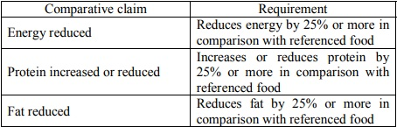
Optional Labeling Items
Claims – if a nutrition component:
  Meets content requirements and restrictive conditions in Table C.3 → Nutrition Comparative Claim
  Referenced food should be
    A food of the same type and
    Familiar to consumers.
GMA Webinar – 17Jan2018
Notes:
23

Slide 24



Optional Labeling Items
Claims – if a nutrition component:
  Meets requirement of content claim or comparative claim
  → Nutrition Function Claim
GMA Webinar – 17Jan2018
Notes:
24

Slide 25


Other Labeling Standards:
GB 13432-2013 Labeling of Prepackaged Foods for Special Dietary Uses
GB 10789-2015 General Standard for Beverage
Safety standards/Hygienic standards/Product standards
China Nutrition Society recently issued the voluntary "Use Norms of “Healthier Choice Symbols (HCS)” for Pre-packaged Food" (Trial)
China National Food Industry Association recently issued “Guideline for Iconic Nutrition Label for Prepackaged Food (draft)”
GMA Webinar – 17Jan2018
Notes:
25

Slide 26
China Labeling
Thank you

Slide 27
China food contact regulations
Huqiu Zhang, PhD.
GMA Webinar
January, 17, 2018

Slide 28
Government agencies responsibility
CFSA
Establish regulations and National Standard
NHFPC
Approve new substance
AQSIQ
QS certification
Market supervision
Policy setting
Enforcement
New approval
CFSA: Center for Food Safety Risk Assessment, became part of NHFPC
NHFPC: National Health and Family Planning Commission
AQSIQ: General Administration of Quality Supervision, Inspection and Quarantine

Slide 29
China food contact regulation overview
No danger to human health
No change to food composition
No change to organoleptic properties of food
1. Framework
Regulation
2. Material Regulation
3. Good Manufacturing Practice
Same principle as EU and US food contact regulations;
Details have differences
Food Contact Compliance
Regulations to govern use of material
Positive list of materials cleared or approved by government agencies
Compliance testing requirements
Quality system and manufacturing processes in place to avoid contamination in manufacturing
Use of material at the level only to achieve technical function
Suitable purities
29

Slide 30
China food safety law – food contact regulation legal basis
Article 2
Anyone engaging in following activities shall abide this law:
(3) Manufacture or sell food packaging materials, food contact containers, detergents, disinfectants and food process tools and equipment (hereinafter referred to as food-related products).
...... And other relevant Articles in Food Safety Law

Slide 31
Overview of china food contact gb standards
Food Contact GB Standards
Horizontal Standard
Material Standards
Manufacturing
Practice
Migration Test
Standards
GB4806.1-2016
General Safety
GB31603-2015
GMP
GB31604.1-2015
General Principle
GB9685-2016
Additive positive list
GB5009.156-2016
Pre-treatment
Resin, material
and articles
Rubber and articles
Ceramic
Adhesive
Printing ink*
Paper and
paperboard
Coating
Enamel
Bamboo and
Wood*
Textile*
Metal and alloy
Glass
Detergent and
disinfectant
Lubricant*
Multilayer material*
* In preparation

Slide 32
Other material gb standards

Slide 33
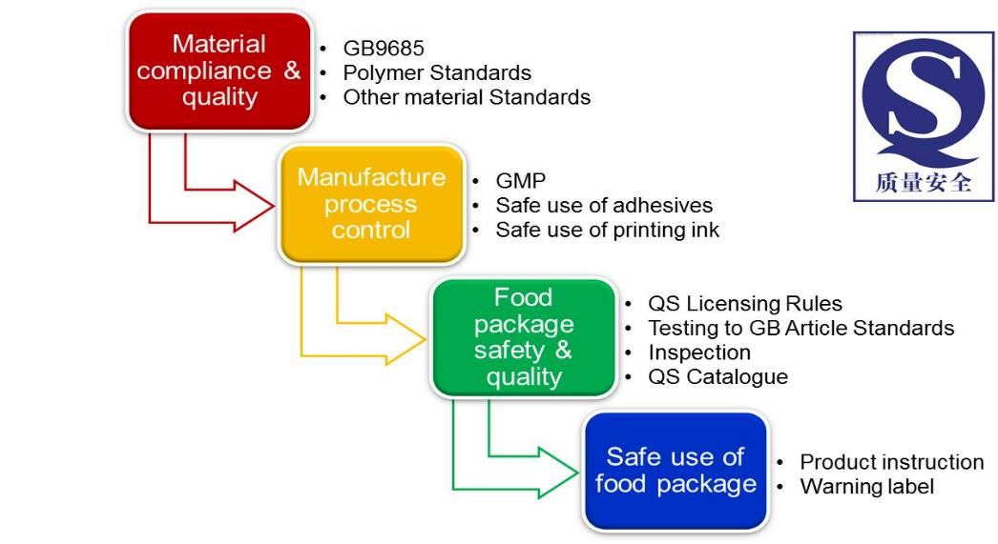
Manufacture In china - Food contact product production license

Slide 34
Importing to china - Food contact product registration
Product Registration
Product must be registered with CIQ of port of entry through application process and with compliance report
Product Inspection
Product will be inspected during registration
Supervision Management
Label and documents must be in Chinese
Registration valid for 3 years
Annual inspection will be conducted afterwards
Document traceability

Slide 35
Product information and labeling - Gb4806.1-2016
Product Information and Labeling
Product identification must be clear and accurate, and may not mislead the users
Sufficient product information must be provided, in order to be able to conduct safety assessment, when needed
Identification information should include name of product, material, declaration of compliance with relevant laws, regulations and standards, name/address/contact information of the manufacturers or distributors, and date and expiation date
DOC must include the laws, regulations and standards, with limits and restrictions and confirmation of passing OM test on final article
The symbol of spoon-chopsticks must be labeled for the food contact materials or articles, with use limitations if necessary
If the above mentioned information cannot be fully displayed on the product for technical reason, such information may be displayed in the instruction manual or accompanying documents

Slide 36

Compliance test requirements
Physicochemical specification
Sensory test for certain materials
Overall migration test
Specific migration test
Potassium permanganate consumption
Discoloration test for colored products
Microbial testing for certain materials

Slide 37

Challenge with Compliance with other countries but China
Challenges:
Food Contact product or food package compliant with other countries regulations does not necessarily comply with China GB standards
Material GB standards have differences from other countries material regulations
Compliance testing requirements have similarities but also have differences
Labeling differences
EU
China
Practical Solutions:
Choose material from Chinese Positive Lists
If not on Chinese Positive List, file Food Contact Notification to the have material listed
Optimize migration testing condition to cover all applicable regulations by using most stringent test conditions

Slide 38

China Compliance in summary
Framework GB standard must always be followed
Food contact materials and products must meet the corresponding materials and articles GB standards
Compliance testing must be performed to have passing results
GMP must be applied in manufacturing
Declaration of Compliance (DoC) documentations
Label is required for the compliant food contact materials or articles
Manufacturing license should be applied for finished articles in order to use the AQSIQ logo
Product registration is required for importing food contact product into China

Slide 39


Huqiu Zhang, PhD
+1 630 481 3150
Huqiu.zhang@intertek.com
intertek.com/product-assurance/chemical-management
Interested in learning more about food contact regulation? Check out our upcoming Global Food Contact & Food Packaging Safety and Regulatory Compliance seminar!

Slide 40
China Regulations – Food Contact
Rich LeNoir
GMA Webinar
17 January 2018

Slide 41
China GMP
GB 31603-2015
  General Hygienic Specifications for Production of Food Contact Materials and Articles
  Came into force 16 September 2016
  Standard defines the basic hygienic requirements and management guidelines for places, facilities and personnel in each step of production, including raw materials purchasing, processing, packaging, storage and transportation etc. for food contact materials and articles
  Applies to all types of food contact materials and articles
Notes:
41

Slide 42
China GMP
Basics
  The process and final products shall not endanger human health or change the food characteristics
  Process shall be consistent with all laws, regulations and standards
  To achieve the final purpose, the use of raw materials are minimized as much as possible
    To achieve this, businesses must establish specific requirements
  Business shall have an effective safety control system to ensure raw materials, semi-finished products and finished products conform to applicable food safety requirements
  Identification of products shall comply with applicable laws, regulations and standards
GMA Webinar – 17Jan2018

Slide 43
China GMP
Factory Environment
Plant Design
Facilities and Equipment
Personnel
Requirements for Raw Materials
  Management systems shall be established for Purchasing, Acceptance, Transportation, Storage, Suppliers
GMA Webinar – 17Jan2018

Slide 44
China GMP
Product Safety Control in the Production Process
  Hygiene requirements for Production and Processing
  Hygiene requirements for Printing
  Hygiene requirements for Packaging, Storage and Transportation
Management Department
  Oversee the safety and hygienic requirements that are established for the business
  Training
GMA Webinar – 17Jan2018

Slide 45
China GMP
Inspection
  Can be internal or contracted to a third party
  In accordance with the applicable standards, each batch of product shall be randomly sampled, the factory inspection shall be made, and the factory inspection record systems shall be established and maintained
  Storage of samples – establish management system
Product Traceability and Recall
  Management system for traceability, recall and customer complaints shall be established
Document Management and Records
  Systems to produce, store and retrieve documents for all the operations shall be established.
GMA Webinar – 17Jan2018

Slide 46
China GMP
GB 4806.1-2016
  General Safety Requirements for Food Contact Materials and Articles
  Specifies the basic requirements, limit requirements, compliance principles, test methods, traceability and product information of food contact materials and articles
  Applies to all types of food contact materials and articles

Slide 47
China GMP
Basic requirements
  Migration to food not harmful
  Contact does not change food organoleptic properties
  Substances used food contact materials and articles will be in the lowest amounts to accomplish the technical effect
  Not intentionally added substances are controlled and assessed
  Barrier layer assessments
  GB 31603 compliance as well
Limit requirements
  General requirements: comply with OML, SML, SML(T), ML, QM
  Special requirements

Slide 48
China GMP
Conformity Principles – use of substances conforms with the applicable standards and materials and articles conform appropriately
Test Methods
  GB 31604.1
  GB 5009.156
Traceability – a system shall be established

Slide 49
China GMP
GB 4806.7-2016
  National Food Safety Standard:
  Food Contact Plastic Materials and Articles
  5.2 Label Identification
    Label identification shall comply with the provisions under GB 4806.1. In addition, the names of the resins shall be marked on the product labels, in the specifications or in the attached documents according to Appendix A of GB 4806.6-2016, and the names of all resins shall be indicated for polymer blends.

Slide 50
China – DoC Food Contact
GB 4806.1-2016
  Food Contact Materials and Articles – General Safety Requirements
  Item 8.4 - The declaration of conformity (DoC) shall cover the following information:
    laws, regulations and standards of compliance;
    list of restricted substances and their restrictive requirements;
    compliance information of overall migration (only for molded product).

Slide 51
China – DoC Food Contact
DoC
  No specified format at this time
  May be helpful to have it in Chinese as well as English
Basic Information for DoC
  “This product complies with the relevant requirements in” the appropriate regulations:
    GB 9685-2016
    GB 4806.1-2016
    GB 4806.x-2016, where x is 6, 7, 8, etc.

Slide 52
China – DoC Food Contact
Basic Information for DoC (cont’d)
  Restricted substances and their restrictions
    SML, SML(T), etc.
    Maximum Levels (substances)
  Any usage restrictions
    Food type limitations
    Temperature limitations
    Substrate restrictions
      e.g. polymer type
      e.g. not for adhesives

Slide 53
China – DoC Food Contact
Basic Information for DoC (cont’d)
    GMP statement
    The production process is in line with the relevant principle requirements in GB 31603-2015 applicable to the production of chemical substances or materials or articles.

Slide 54
Panel Discussion

